Slide 1
Is Node.js Really Single-Threaded
Objectivity Front-End Community
Sergii Trotsenko

Slide 2
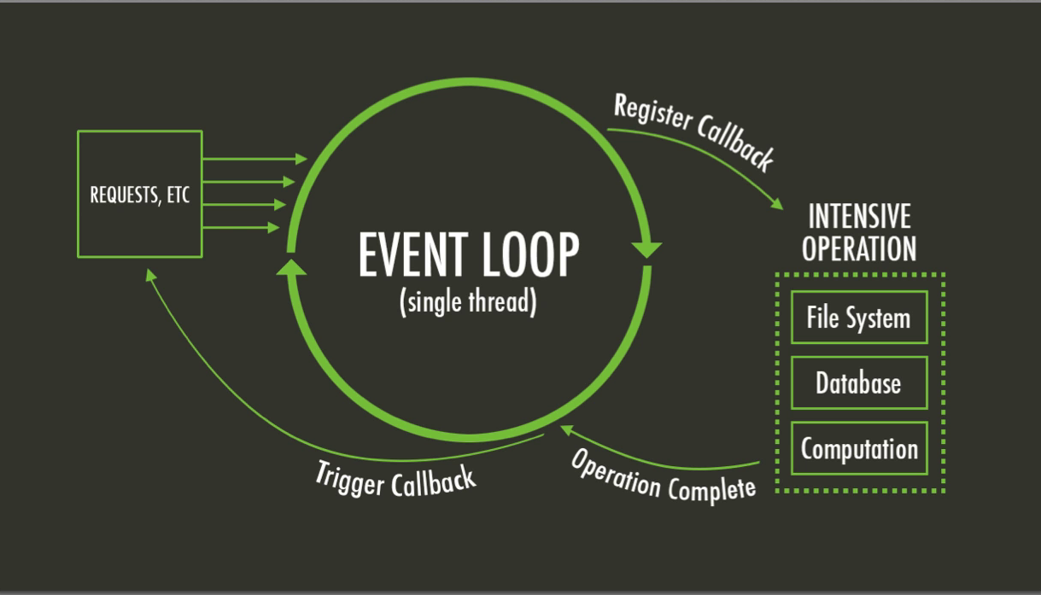
Node.js Official Architecture
single threaded
event-driven
non-blocking I/O

Slide 3
Main Thread
All JavaScript code
V8
Event loop
*Sync methods

Slide 4
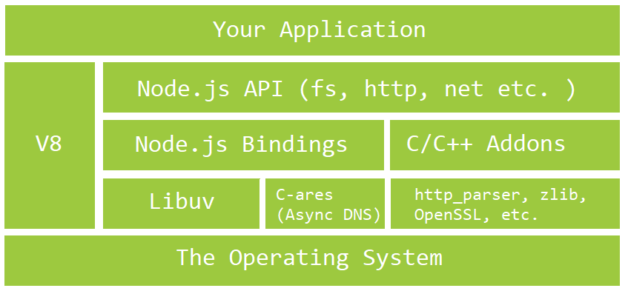
Node.js Real Architecture
Notes:
V8 - JavaScript engine implemented in C++. Compiles JS into machine code.
Libuv - the C library that provides asynchronous features. It maintains an event loop, a thread pool, file system events, and child processes.
Bindings: expose core Node.js internal libraries written in C/C++ (c-ares, zlib, OpenSSL, http-parser, etc.) to JavaScript.
C/C++ Addons: Bindings only provide glue code for Node.js’ core internal libraries, i.e. zlib, OpenSSL, c-ares, http-parser, etc. If you want to include a third-party or your own C/C++ library in your application, you would have to write the glue code for that library yourself. These glue code you write are called addons.

Slide 5
Outside Main Thread
Built-in Network I/O (OS)
File I/O, DNS, Crypto etc. (Thread pool)
Child Processes
Worker Threads
C++ Addons
Cluster

Slide 6
Links
Source Code - GitHub
Don't Block the Event Loop (or the Worker Pool) – article
You Don't Know Node – presentation Samer Buna
Mastering Node.js – book
Advanced Node.js – Pluralsight course

